Slide 1
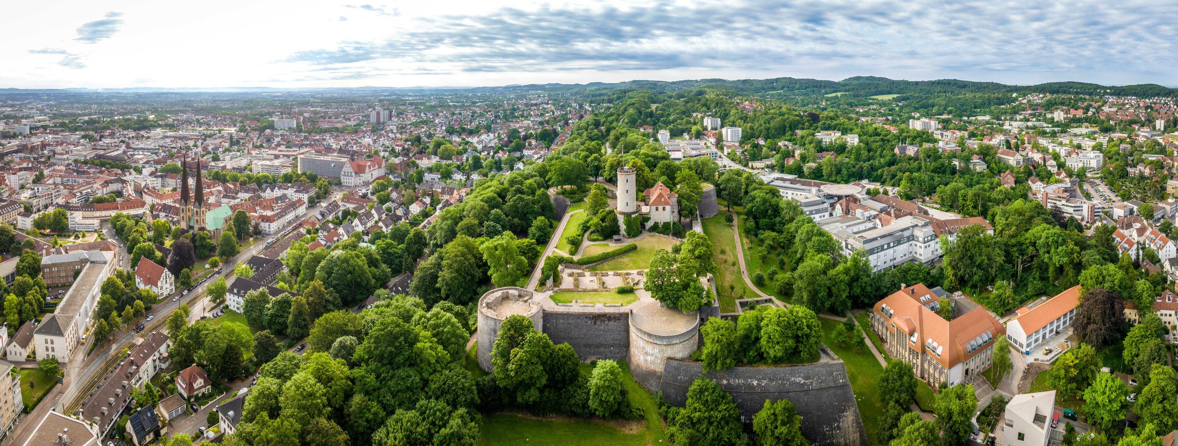
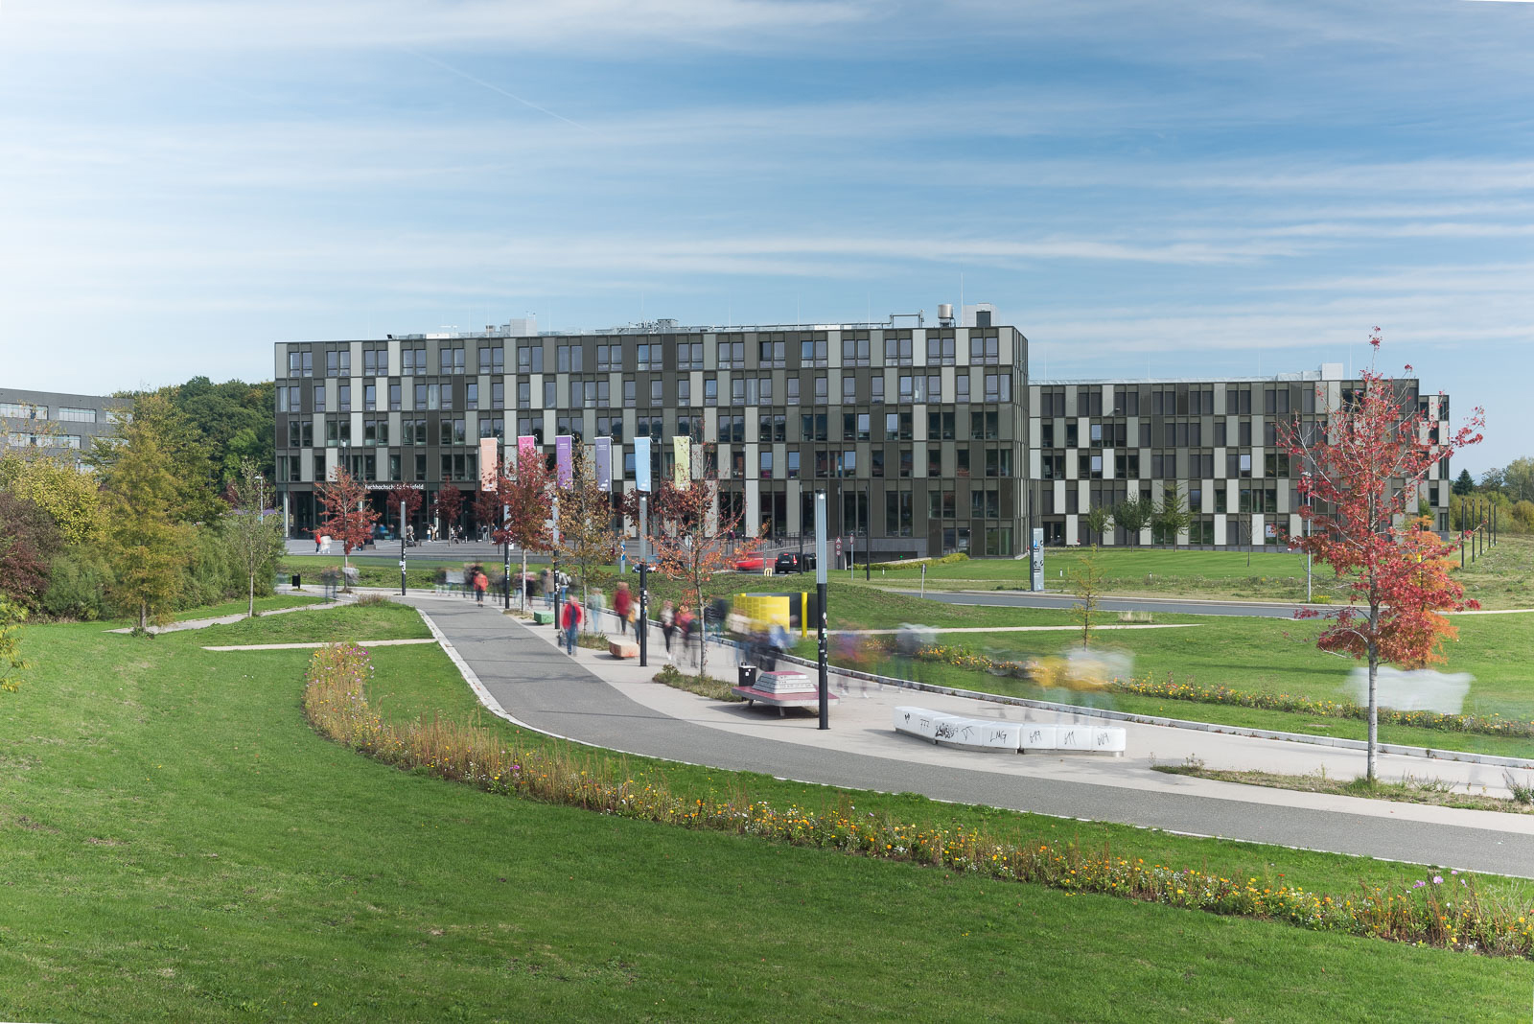


EOOLT 2026 10th International Workshop on Equation-Based Object-Oriented Modeling Languages and Tools
Copyright Teutoburger Wald Tourismus / D. Ketz
The topics covered will range from language design, formal semantics via modeling aspects to generation of simulation code. Contributions can be submitted either as full papers or as 4-page work-in-progress papers.
June 2026 (to be confirmed)
Bielefeld, Germany
Submission deadline: March 2026
Author notification: April 2026
Camera-ready: May 2026
General Chair:
Bernhard Bachmann
Hochschule Bielefeld University of Applied Sciences and Arts
Program Chair:
Benoît Caillaud
INRIA Rennes
National Institute for Research in Computer Science and Control
Copyright: HSBI | Andreas Jon Grote
https://eoolt.org

